Slide 1
Security in modern computing: Cloud and Fog

Slide 2
Survey on cloud computing
Cloud computing uses cloud server stack where the client or user is on the front end and server on the back end, services reside in middleware of stack at the top level resides the application, which directly delivers the outsourced software to the client and eliminates sophisticated software.
Cloud computing offers mainly three service delivery models; Infrastructure as a Service (IaaS), Platform as a Services (PaaS) and Software as a Service (SaaS).
NIST defines four-development model of the cloud: public, private, hybrid and community.

Slide 3
Cloud service delivery models
Infrastructure as a service (IaaS) It belongs to the bottom of the model. IaaS deals with computer hardware (network storage, virtual server/machine, data center, processor, and memory) as a service.
Platform as a service (PaaS): It is in middleware of service model and it delivers the services in the form of development tools, framework, architecture, programs, and Integrated Development Environments (IDE). In other words, the customers are able to control the applications but do not have any means to manage the underlying infrastructure.

Slide 4
Cloud delivery service models
Software as a service (SaaS) It is a collection of remote computing services. SaaS is at the top model among the delivery models. It allows the applications to deploy remotely by third-party vendors. It allows the customer to use cloud service provider’s application (CSP’s) running on cloud infrastructure via the internet.
Anything as a service (AaaS) It is a collective term which combines a number of things as X as a service. X may be anything or everything as a service. This service becomes interchangeable in cloud landscape. The cloud system are able to support the large resource to specific, personal and granular requirements using Monitor as a Services (MaaS), Data as a Service (DaaS), Communication as a Service (CaaS), Security as a Service (SecaaS), Routing as a Service (RaaS).

Slide 5
Cloud deployed models
Private cloud: Cloud computing operates and manages within the data center of an organization is called a private cloud.
Public cloud: It is the true representation of cloud hosting where the customer and provider have a strong Service Level Agreement (SLA) to maintain the trust between them. In this cloud infrastructure, open access to the public and organization provided.

Slide 6
Cloud deployed model
Community cloud: Cloud infrastructure of the organizations shared concerns (mission, security requirements, policy, and compliance considerations) of consumers a special provision has been made for exclusive use by the community model.
Hybrid cloud: It is the combination of two or more clouds (public, private, community). Usually, the data and application are bound together by standardized and propriety technology. Hybrid cloud offers the advantages of different clouds deployment models.
Virtual private cloud: It is a semi-private cloud, which is fewer resources, and it consists of virtual private network (VPN). It is on demand configurable pool of shared resources allocated within the cloud environment.

Slide 7
Cloud computing basic component
VIRTUALIZATION
MULTI-TENANCY
CLOUD STORAGE
THE HYPERVISIOR
CLOUD NETWORK

Slide 8
Threats to security in cloud computing
Basic Security :-
SQL injection attacks: These attacks are the one in which a malicious code is inserted into a standard SQL code and thus the attackers gain unauthorized access to a database and become able to access sensitive information.
Cross-site scripting (XSS) : is a type of computer security vulnerability typically found in web applications. XSS enables attackers to inject client-side scripts into web pages viewed by other users.

Slide 9
Network level security
DNS ATTACKS : A Domain Name Server (DNS) server performs the translation of a domain name to an IP address. Since the domain names are much easier to remember. Hence, the DNS servers are needed. But there are cases when having called the server by name, the user has been routed to some other evil cloud instead of the one he asked for and hence using IP address is not always feasible.
SNIFFER ATTACKS : These types of attacks are launched by applications that can capture packets flowing in a network and if the data that is being transferred through these packets is not encrypted, it can be read and there are chances that vital information flowing across the network can be traced or captured.

Slide 10
Application Level Security
DENIAL OF SERVICE ATTACKS : A DoS attack is an attempt to make the services assigned to the authorized users unable to be used by them. In such an attack, the server providing the service is flooded by a large number of requests and hence the service becomes unavailable to the authorized user.
COOKIE POISONING : It involves changing or modifying the contents of cookie to make unauthorized access to an application or to a webpage.

Slide 11
Application level security
DISTRIBUTED DENIAL OF SERVICE ATTACKS : In D-DoS the attack is relayed from different dynamic networks which have already been compromised unlike DOS. The attackers have the power to control the flow of information by allowing some information available at certain times . Thus the amount and type of information available for public usage is clearly under the control of the attacker.

Slide 12
Ensuring security Against various type of attacks
Web security clouds security architecture rests on two components:
a. Multi layer security: In order to ensure that data security and block possible malwares, it consists of multi-layer security and hence a strong security platform.
b. URL filtering: It is being observed that the attacks are launched through various web pages and internet sites and hence filtering of the web-pages, ensures that no such harmful or threat carrying web page gets accessible. Also, content from undesirable sites can be blocked. With its adaptable technology, it provides security even in highly conflicting environments and ensures protection against new and converging malware threats.

Slide 13
Man in the middle attack
If secure socket layer (SSL) is not properly configured, then any attacker is able to access the data exchange between two parties. In Cloud, an attacker is able to access the data communication among data centers.
Mitigation: Proper SSL configuration and data communication tests between authorized parties can be useful to reduce the risk of Man-in-the-Middle attack. 10

Slide 14
DoS and D-DoS attacks
The symptoms to a DoS or DDoS attack are: system speed gets reduced and programs run very slowly, large number of connection requests from a large number of users, less number of available resources. Although when launched in full strength DDoS attacks are very harmful as they exhaust all the network resources. Mitigation: A careful monitoring of the network can help in keeping these attacks in control.

Slide 15
Simulation Of DDOS attack Using Nessi2
Features Of Nessi2 :-
NeSSi2 is designed to extend conventional network simulation tool features by supporting detailed examination and testing opportunities of security-related network algorithms, detection units and frameworks. The main focus of NeSSi2 is to provide a realistic packet-level simulation environment as a testbed for the development of new detection units as well as existing ones.NeSSi2 has been designed as a modular application with the focus on extensibility. In particular, NeSSi2 provides out-of-the-box support for various protocols of the TCP/IP stack.

Slide 16
Traffic Generation :-
Network traffic in the form of IP packets, complete with header and body, can be generated by different means. Implementing the TCP/IP protocol stack, NeSSi2 features an application layer module which is based on standard Java socket implementations. NeSSi2 incorporates several application level protocols (HTTP, SMTP, etc.) and supports static and dynamic routing protocols which can be selected by the user.
Protocol Stack and Socket-based API :-
The routers as well as the end devices in the simulation contain a Network Layer; end devices also exclusively have a Transport and an Application Layer. At the Network Layer, IPv4 is realized with the key features global addressing, routing and fragmentation support. Moreover, TCP/IP model implementation allows containing several protocols in each layer.

Slide 17
Components of nessi2
Graphical User Interface -
GUI of NeSSi2 has two use cases: On the one hand, results of running or terminated simulations can be visualized in here. On the other hand, it is the component that allows the creation and modification of network topologies and scenarios. A project consists of a root folder, some predefined sub folders and some files created by the user. The root folder is named after the project, whereas the sub folders are named after the element types they contain. NeSSi2 project files include the following types: networks, applications, profiles, scenarios, simulations, recorder configurations and the optional templates.

Slide 18
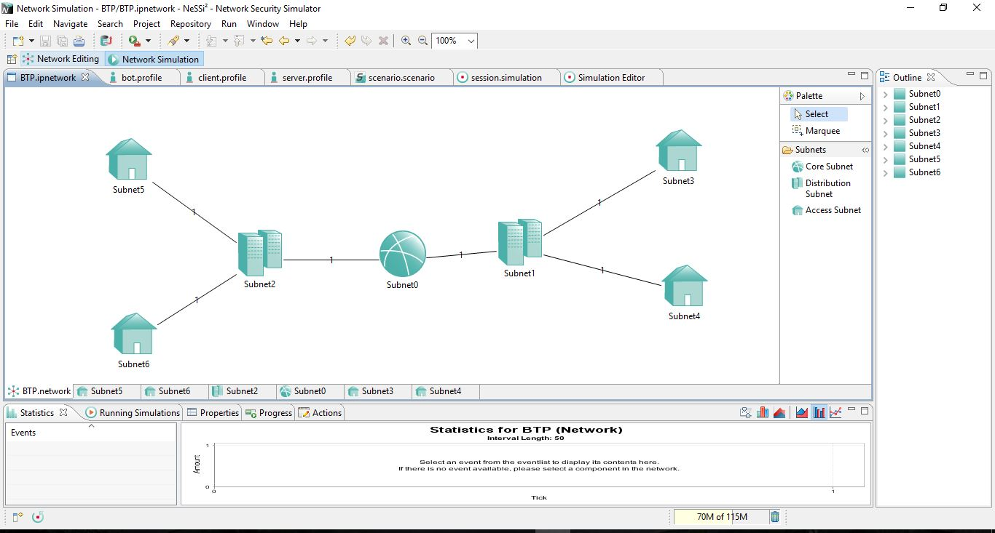

Slide 19
Simulation Backend -
The actual simulation is performed on a machine with hardware dedicated solely to this purpose, the simulation backend.Once a simulation is submitted for execution, the simulation backend parses the desired simulation parameters creates a corresponding simulation environment, sets up the database connection and schedules the simulation to run as soon as the necessary processing resources are available.
Database -
The accurate reproduction of a simulation enables users to use different detection methods or various deployments of detection units for the same traffic data set. This allows the comparison of performance and detection efficiency of different security framework setups. For these purposes, we use a distributed database in which the traffic generated during a simulation is stored.

Slide 20
How we created d-dos simulation
Create Nessi2 project
Create Network
Create Profile
Create Scenario
Create Simulation
Record Configurations
Results and Simulations

Slide 21
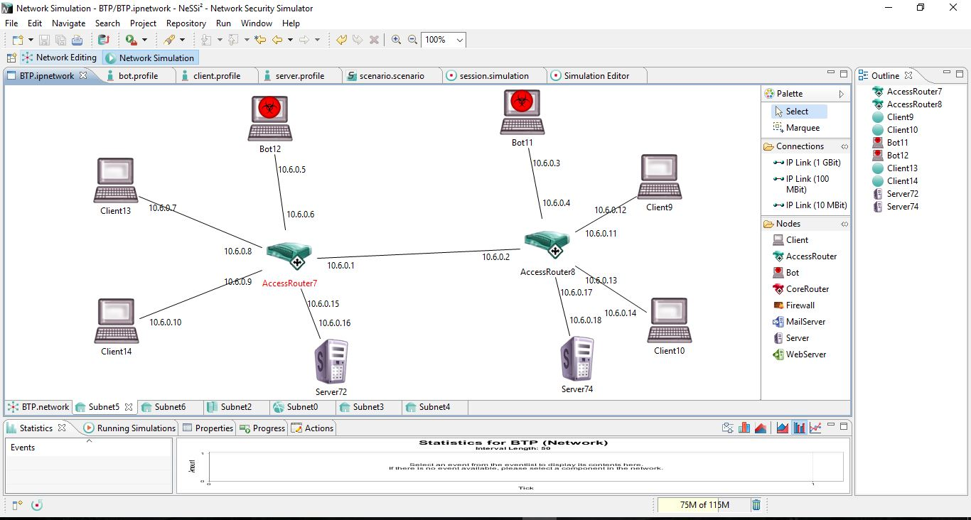
RESULT AND SIMULATION

Slide 22
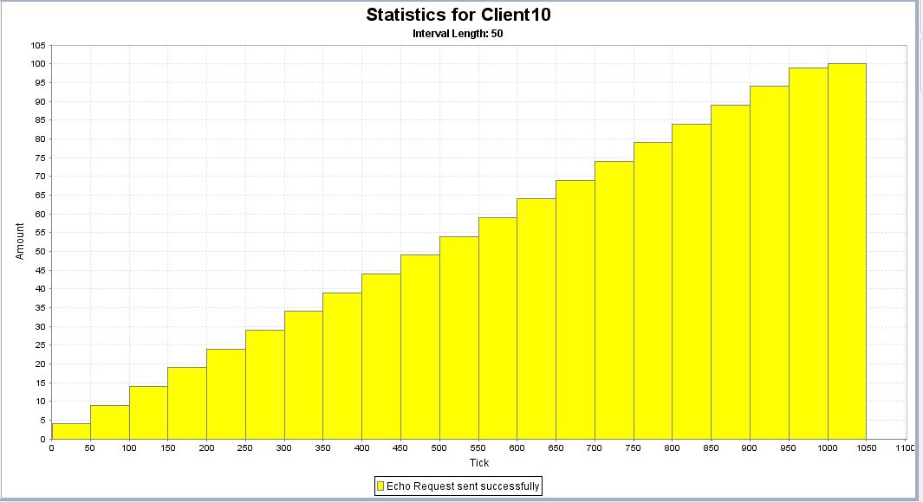

Slide 23
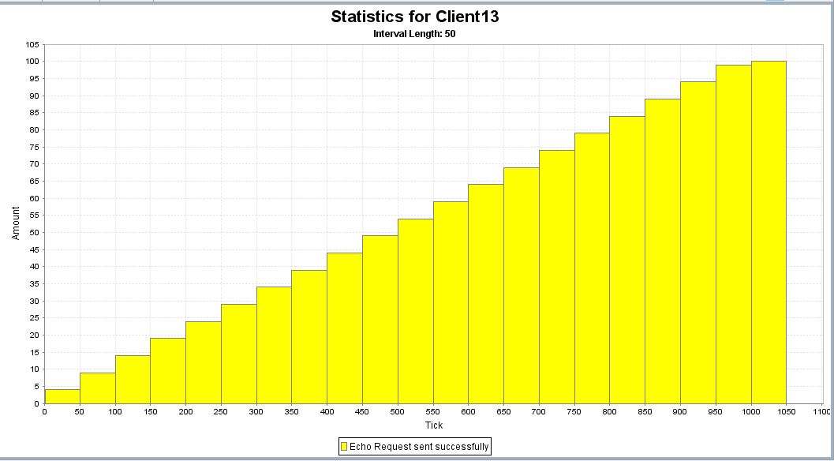

Slide 24


Slide 25
Prepared by-
LOKESH KAUSHIK (14UCS059)
HARSH THAKUR (14UCC011)
SIYARAM SAURABH DWIVEDI (14UEC104)
SUDHANSHU SINGH (14UCS128)

Slide 26
THANKS

